Slide 1
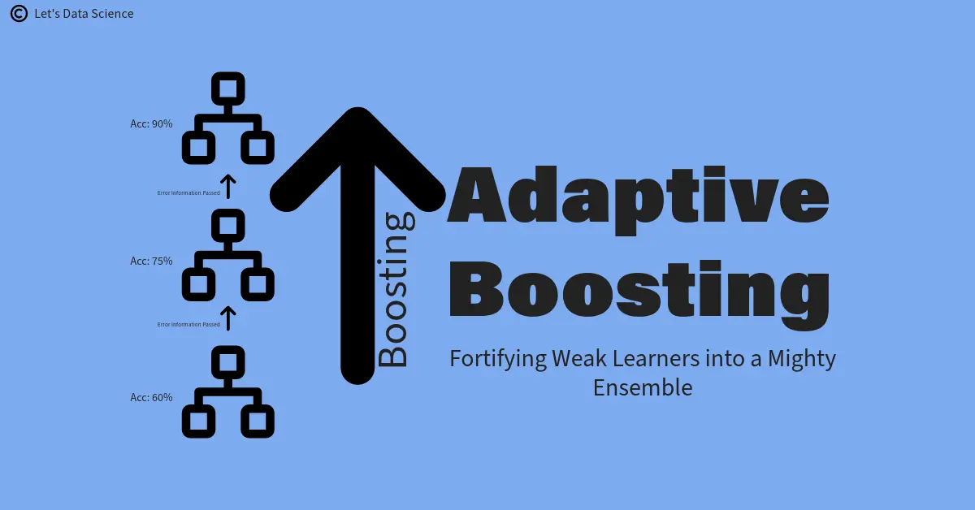
ADABOOST
Adaboost is one of the first boosting algorithms to be introduced.

Slide 2
An AdaBoost regressor is a meta-estimator that begins by fitting a regressor on the original dataset
Then fits additional copies of the regressor on the same dataset.
But where the weights of instances are adjusted according to the error of the current prediction.

Slide 3
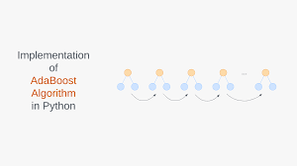
Adaboost uses weighted errors to build strong classifier from a series of weak classifiers

Slide 4
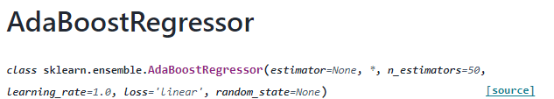
AdaBoost requires minimal tuning of hyperparameters i.e., the number of iterations or weak learners, making it easy to use.

Slide 5
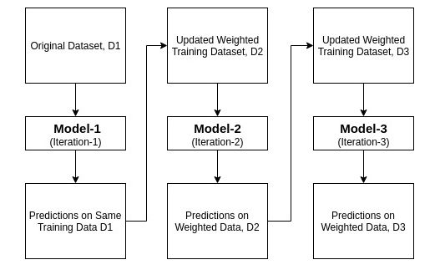
The below picture illustrates, how Adaboost is using weighted errors to build a strong dataset for better prediction

Slide 6
Adaboost advantage, disadvantage and applications:
Advantage:
Its robustness, scalability and speed
It has high degree of interpretability, and has high accuracy
Disadvantage:
Sensitivity to Noisy data, Complex implementation, Vulnerability to outliers
Applications:
Face detection, object recognition, and text classification

